Slide 1
Unit 2 Computer Software

Slide 2
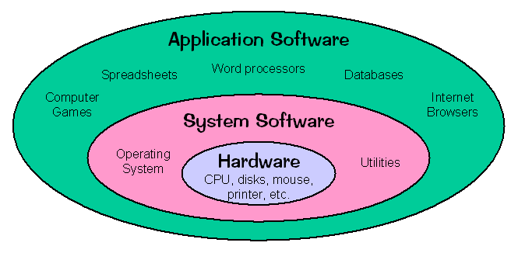
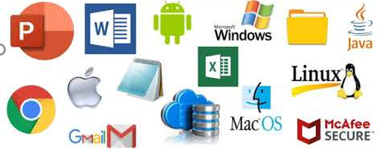
Software
Software is a set of instructions that tell a computer what to do. It is set of interrelated computer programs and documentation that contains information how to use it.
There are two main types of software:
System Software
Application Software

Slide 3
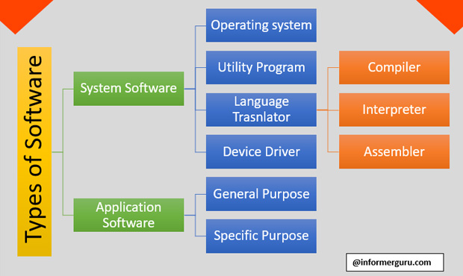
Types of Software

Slide 4
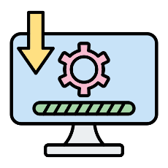
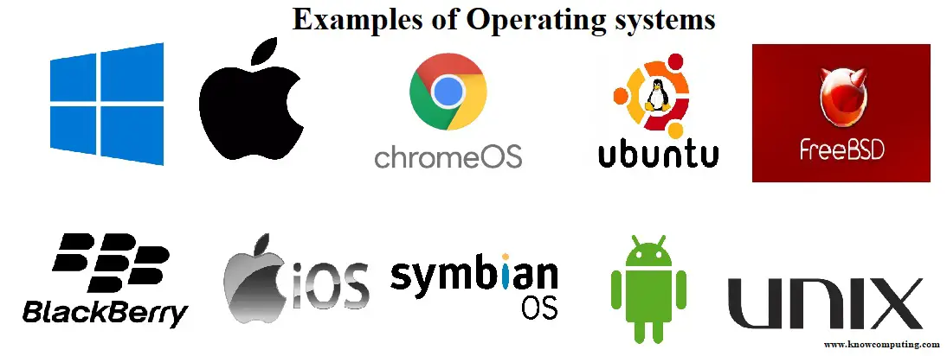
System software
System software which controls the computer’s all hardware resources and performs tasks that are essential to the operation of the computer.
It provides intermediary medium between the user and computer hardware.
Application software run over system software.
Types of System Software:
Operating System : It is integrated set of programs that is used to manage the various resources and overall operation of the computer system.
Translator : Assembler, Compiler and Interpreter
Utility software: It system software which enhance or extend the system software capabilities or offer new features not provided by Operating system.

Slide 5
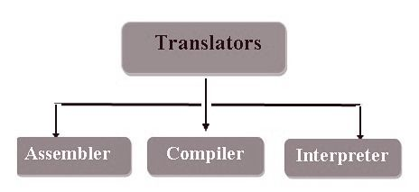
Language Translator
Language translators allow computer programmers to write sets of instructions in specific programming languages. These instructions are converted by the language translator into machine code. The computer system then reads these machine code instructions and executes them.

Slide 6
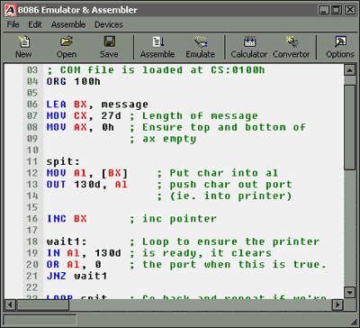
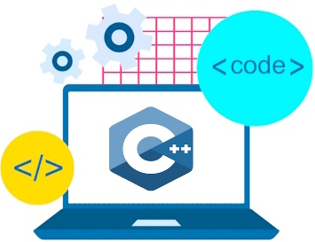
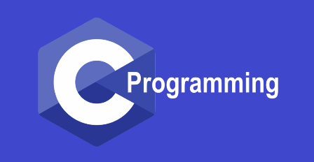
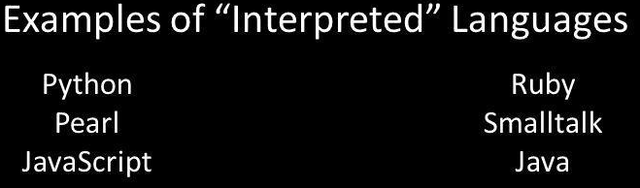
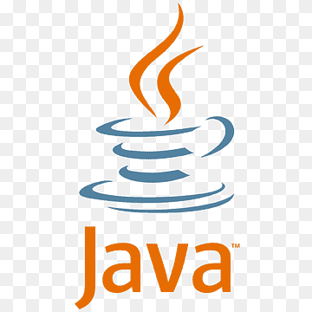
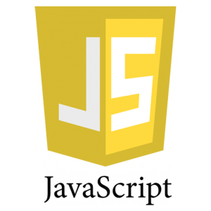

Language Translator
Translator : Assembler, Compiler and Interpreter

Slide 7
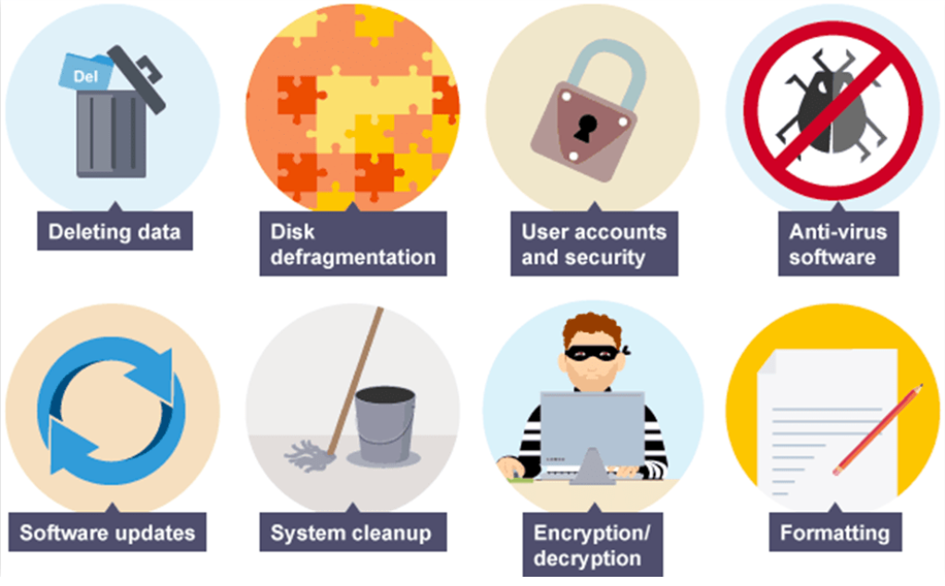

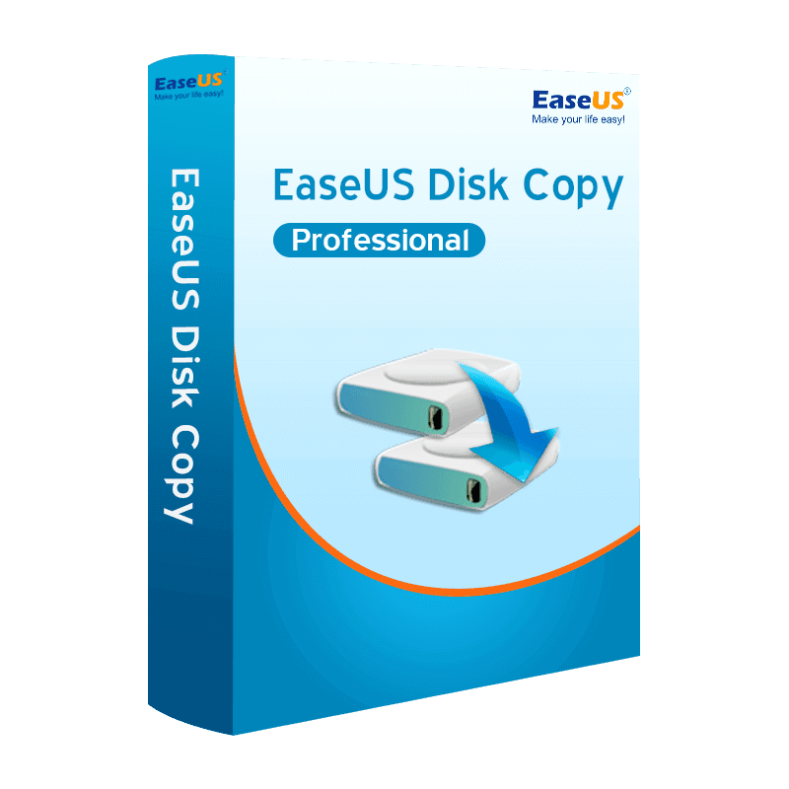
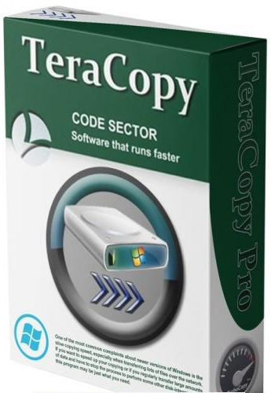
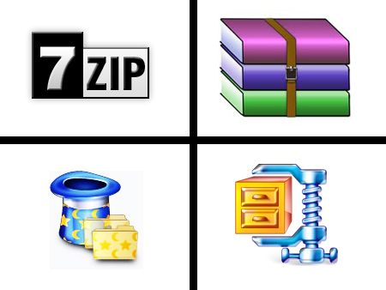
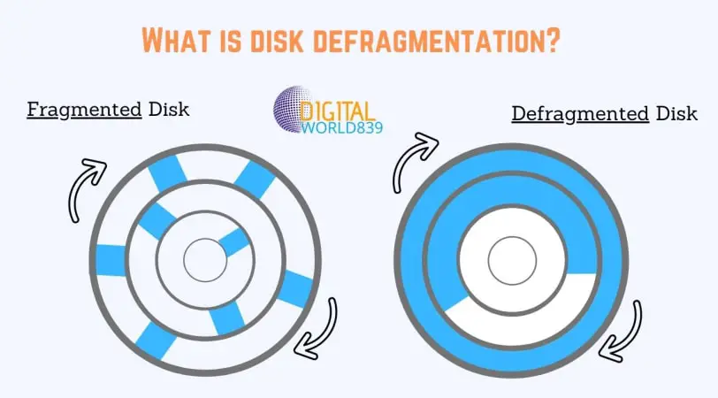
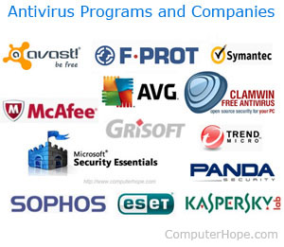
Utility Software
It is system software that enhance or extend the system software capabilities or offer new features not provided by Operating system. It keeps system updated , make sure system is working perfectly and protect the system and data from potential intrusion and damage.

Slide 8
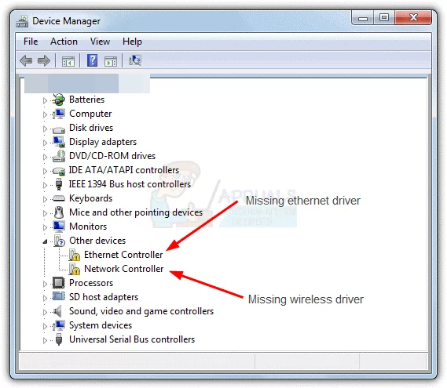
Device Drivers
A device driver is a piece of software that allows the operating system to communicate with a specific hardware device. It acts as an intermediary between the device and the operating system, translating the commands and requests of the operating system into actions that the device can understand and vice versa.
Device drivers are essential for the proper functioning of hardware devices and are usually provided by the manufacturer of the device. They are usually specific to a particular device and operating system, and must be installed on the computer before the device can be used.

Slide 9
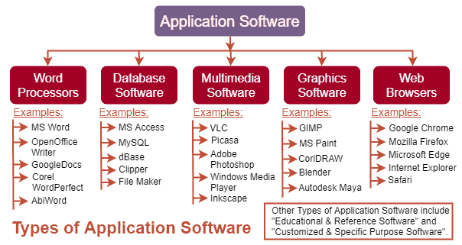
Application software
Application software is a type of computer software that is designed to perform the user perform specific tasks.
Examples of application software include word processors, spreadsheet programs, and media players. Unlike system software, which is responsible for the basic operation of the computer, application software is designed to perform more specialized tasks and is used by the user to complete specific work or personal projects.

Slide 10
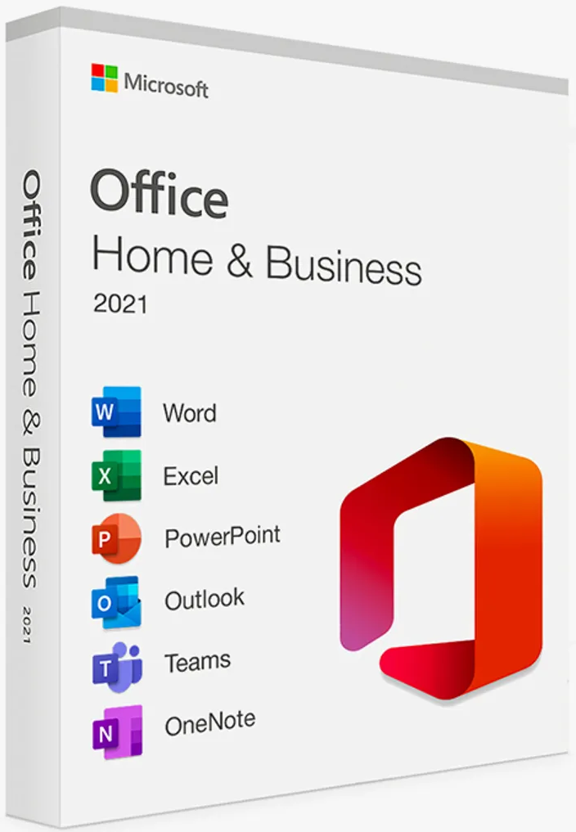
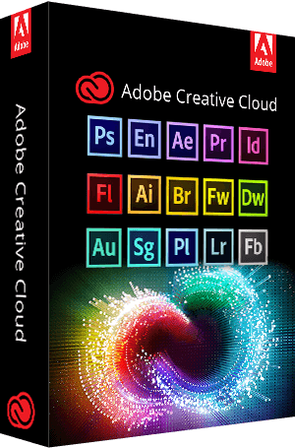
General Purpose Software
General-purpose software is software that can be used for a wide range of tasks, rather than being designed specifically for a particular task or application.
These types of software are designed to be flexible and can be used to perform a variety of different tasks, depending on how they are programmed and configured.
Packaged software is a collection of programs that perform similar functions or have similar features. For example, Microsoft Office includes multiple applications such as Excel, Word, and PowerPoint. Video and audio editing software may also be available as packaged software, used for editing music and video files used in a movie.

Slide 11
Special purpose/ Tailored Software
Tailored software, also known as custom software or bespoke software, is software that is developed specifically for a particular organization or user. It is designed to meet the specific needs and requirements of the organization or user, and is not generally available to the public.
Tailored software is often used to solve a specific problem or to automate a specific process within an organization, and is typically more expensive to develop than off-the-shelf software because it is developed specifically for a single client.
However, it can provide a number of benefits, such as increased efficiency, improved accuracy, and better integration with existing systems, that can outweigh the higher initial cost.
Example: Ticket Booking system, Employee Management system etc.

Slide 12
Question 9
What is Software? What are the types of software? Explain with proper example.

Slide 13
Software Acquisition
The act or process of acquiring software in different ways like purchase, download free from internet or get it bundled along with hardware is called software acquisition. It is the way in which the software are made available to users.
Some of the ways in which the software are made available to users are as follows:
§ Retail software: It is the software sold in retail stores. It comes with printed manuals and installation instructions. For E.g. MS windows OS
§ Original Equipment Manufacturer (OEM) software: It refers to software which is sold, and bundled with hardware. Microsoft sells its operating system as OEM software to hardware dealers. OEM software is sold at reduced price, without the manuals, packaging and installation instructions.
§ Shareware: It is a program that the user is allowed to try for free, for a specified period of time, as defined in the license. It is downloadable from the Internet. When the trial period ends, the software must be purchased or uninstalled.

Slide 14
Software Acquisition
§ Freeware: It is software that is free for personal use. It is downloadable from the Internet. The commercial use of this software may require a paid license. The author of the freeware software is the owner of the software, though others may use it for free. The users abide by the license terms, where the user cannot make changes to it, or sell it to someone else.
§ Open source software: It is software whose source code is available and can be customized and altered within the specified guidelines laid down by the creator. Unlike public domain software, open-source software has restrictions on their use and modification, redistribution limitations, and copyrights. Linux, Apache, Firefox, OpenOffice are some examples of open-source software.
§ Public Domain Software: It is free software. Unlike freeware, public domain software does not have a copyright owner or license restrictions. The source code is publicly available for anyone to use. Public domain software can be modified by the user.
§ Demo Software: It is designed to demonstrate what a purchased version of the software is capable of doing and provides a restricted set of features. To use the software, the user must buy a fully- functional version.

Slide 15
Operating System
An operating system (OS) is a software program that manages the hardware and software resources of a computer.
It acts as a intermediary between the computer's hardware and the programs that run on it, providing a layer of abstraction between the two.
Some examples of operating systems include Windows, MacOS, and Linux.
There are several advantages of an operating system, including:
Resource management, security, compatibility, multitasking, memory management etc.

Slide 16
Function of Operating system
An operating system (OS) performs several functions to manage the resources of a computer and provide an interface for interacting with the computer. These functions include:
Memory management: The OS manages the computer's memory, allocating memory to running programs and ensuring that the computer does not run out of memory.
Process management: The OS manages the execution of processes, including creating, scheduling, and terminating processes.
Input / Output management: The OS manages the communication between the computer and its input/output devices, such as the keyboard, mouse, and monitor.
File management: The OS manages the organization and access of files on the computer's storage devices, including creating, deleting, and modifying files.

Slide 17
Function of Operating system
Protection and Security: The OS provides security features, such as user authentication and file permissions, to prevent unauthorized access to the computer and its files . The OS detects and recovers from errors, such as system crashes, to keep the computer running smoothly.
Device management: The OS is responsible for managing the hardware devices, such as disk drives, printers, and other peripherals, and ensuring their proper functioning.

Slide 18
Types of Operating System
On the basis of User
Single-user, single-tasking OS: These operating systems are designed to be used by one person at a time and can only run one program at a time. Examples include DOS and Windows 3.x.
Single-user, multi-tasking OS: These operating systems are designed to be used by one person at a time, but can run multiple programs simultaneously. Examples include Windows and Mac OS.
Multi-user, Time sharing OS: These operating systems allow multiple users to access the computer simultaneously. Examples include UNIX and Linux.

Slide 19
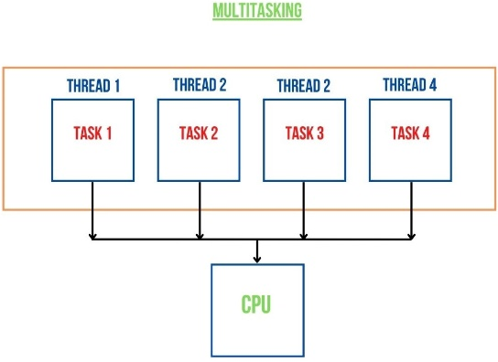
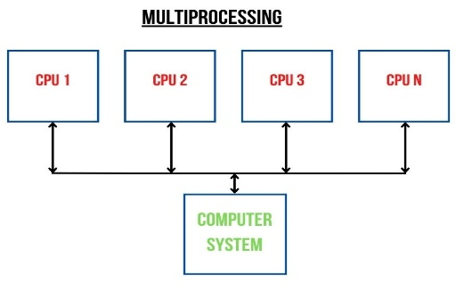
Types of Operating System
On the basis of Processing method
Multiprogramming is a method of executing multiple tasks or processes at the same time, using a single processor. The goal of multiprogramming is to increase the overall utilization of the processor by interleaving the execution of multiple tasks. Suppose, the currently running process is perming an I/O task, at that time it don’t not need CPU, and CPU becomes idle. Then the OS may interrupt that process and give the control to one of the other in main memory programs that are ready to execute. In this way no CPU time is wasted.
Multitasking is a method of executing multiple tasks or processes at the same time, using a single processor. Though we say so but in reality no two tasks on a processor machine can be executed at the same time. Actually, CPU switches from one task to the next task so quickly that it appears as if all the tasks are executing at the same time. The goal of multitasking is to utilize the CPU efficiently and reduce the response time.
Preemptive(Time slicing) Multitasking:
Co-operative Multitasking: Foreground and Background
Multiprocessing is a method of executing multiple tasks or processes at the same time, using multiple processors or cores. The goal of multiprocessing is to increase the overall performance and speed of a computer by breaking down a large task into smaller, more manageable chunks and executing them simultaneously on separate processors or cores.

Slide 20
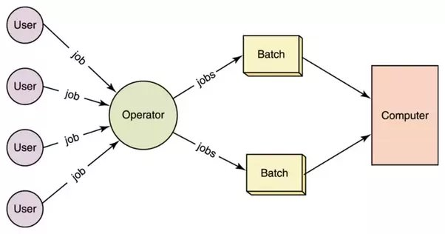
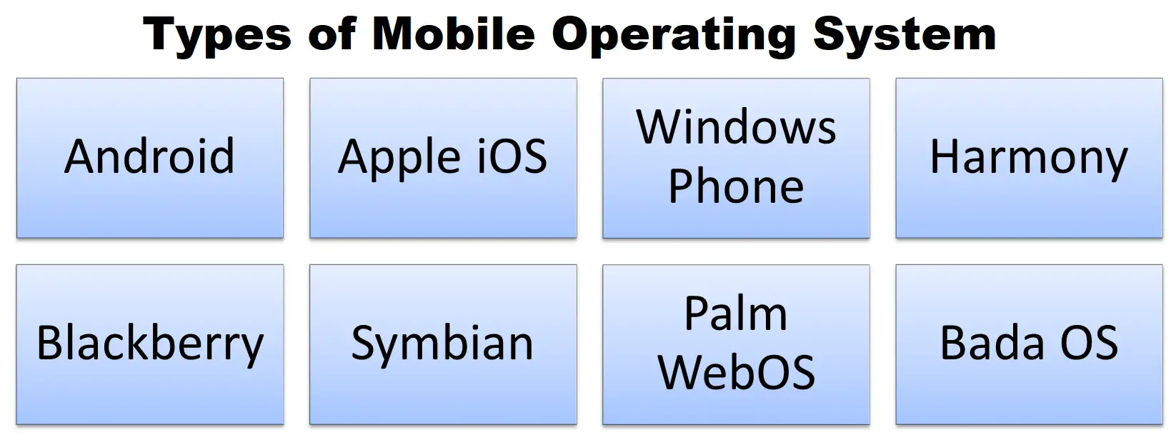
Types of Operating System
Batch Processing OS: A batch processing operating system (OS) is a type of operating system that is specifically designed to manage and execute batch jobs. Batch of tasks which requires similar resources are created first. It was used in second generation computers where punch cards and magnetic tapes were used. These systems are optimized for efficient processing of large volumes of data, and are often used in situations where a large number of similar tasks need to be executed.
Real-time OS: These operating systems are designed to handle time-sensitive tasks, such as controlling industrial systems or managing scientific experiments. Examples include Vx Works and QNX.
Embedded OS: These operating systems are designed to be used in small, specialized devices, such as projector, routers, and appliances.
Mobile OS: These operating systems are designed for mobile devices such as smartphones and tablets. Examples include Android and iOS.

Slide 21
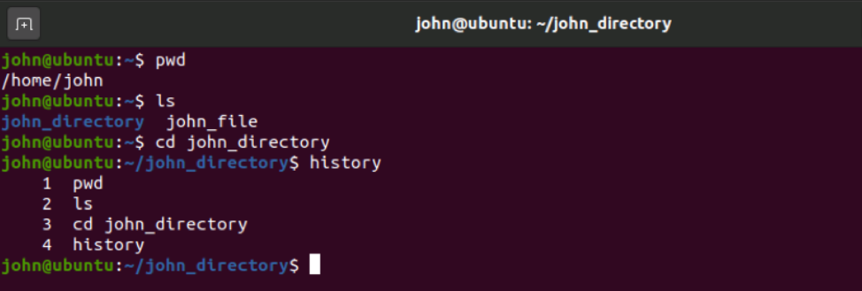
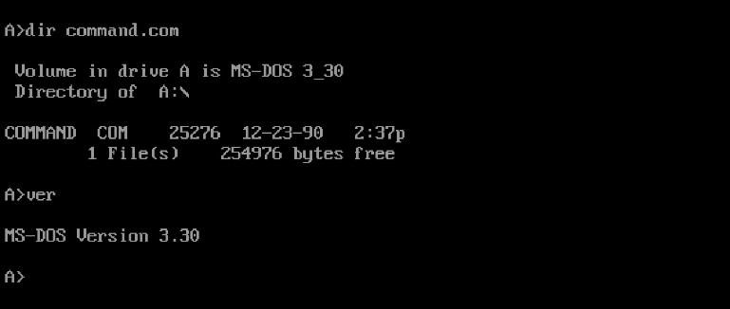
Types of Operating System
On the basis of User Interface
Graphical User Interface(GUI)
Character User Interface(CUI)
Q. Mention difference between GUI and CUI based OS ?

Slide 22
Question 11
What is Operating System? What are the function and types of operating system? Explain in brief.

Slide 23


Computer Virus
A computer virus is a type of malicious software (malware) that is designed to replicate itself and spread from one computer to another. When a virus infects a computer, it can perform a variety of malicious activities, such as deleting files, stealing personal information, and corrupting data.
Viruses are typically spread through email attachments, infected websites, and downloaded files. They can also be spread through removable media such as USB drives and SD cards. Once a virus has infected a computer, it can replicate itself and spread to other computers on the same network.

Slide 24
Types of Malicious Software
Trojan horses: A Trojan horse is a type of malware that is disguised as legitimate software and is designed to gain access to a computer system without the user's knowledge.
Ransomware: Ransomware is a type of malware that encrypts a victim's files and demands a ransom from the victim to restore access.
Adware: Adware is software that displays unwanted advertisements on a computer.
Spyware: Spyware is software that is designed to gather information about a person or organization without their knowledge.
Phishing – Emails can be disguised to be coming from a fraudulent company for the sole purpose of getting you to reveal personal information
Key loggers: Key loggers keep track of your keystrokes on your keyboard and record them on a log. This information is used to gain unauthorized access to your accounts.

Slide 25
Types of malicious software
Denial of Service(DoS) Attack: a denial-of-service attack is a cyber-attack in which the perpetrator seeks to make a machine or network resource unavailable to its intended users by temporarily or indefinitely disrupting services of a host connected to a network.
Others are:
Page hijacking, Click fraud, Salami Slicing, plagiarism etc.

Slide 26
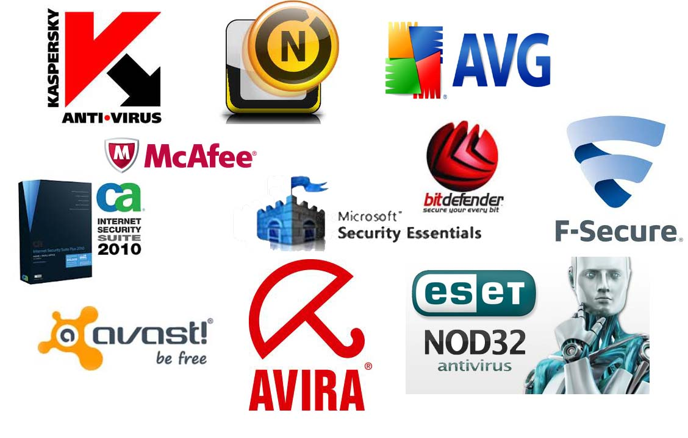
Antivirus
Antivirus software is a type of program that is designed to detect and remove malware from a computer. It works by scanning the computer's files and identifying any that match known patterns of malware. Antivirus software can also detect and prevent the download of new malware by scanning incoming network traffic and email attachments.
Antivirus software is an important tool for protecting a computer against malware such as viruses, worms, and Trojan horses. It is important to keep the antivirus software up to date, as new threats are constantly being discovered. Many antivirus programs offer automatic updates to ensure that the software is able to detect and remove the latest threats.

Slide 27
Question 10
As we know, there are lots of malicious software. In your opinion, what is the most dangerous type of malware and why? What measures do you think individuals and organizations can take to protect against malware attacks?

